Slide 1


Slide 2

CONTENTS
4-1 Be + -ing: the Present Progressive
4-2 Spelling of -ing
4-3 Present Progressive: Negatives
4-4 Present Progressive: Questions
4-5 Simple Present Tense vs. the Present Progressive
4-6 Non-Action Verbs Not Used in the Present
Progressive
4-7 See, Look At, Watch, Hear, and Listen To
4-8 Think About and Think That

Slide 3
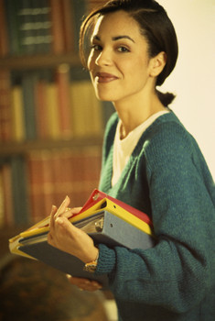
4-1 BE + -ING: THE PRESENT PROGRESSIVE
I am working in the
library right now.

Slide 4
4-1 BE + -ING: THE PRESENT PROGRESSIVE
am + -ing
(a) I am working in the library right now.
is + -ing
(b) Lily is working in the library right now.
are + -ing
(c) You are working in the library right now.
Action is
right now.
am, is, are + -ing
present progressive tense

Slide 5
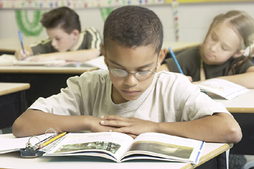
4-1 Let’s Practice
read
What is the boy doing?
is reading
He _________.

Slide 6
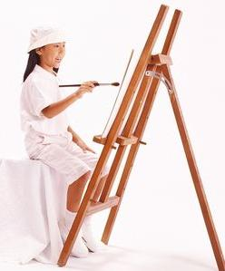
4-1 Let’s Practice
paint
What is the girl doing?
She _________.
is painting

Slide 7
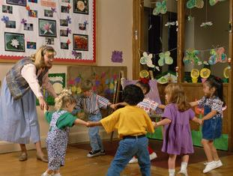
4-1 Let’s Practice
play
What are the children doing?
They _________.
are playing

Slide 8
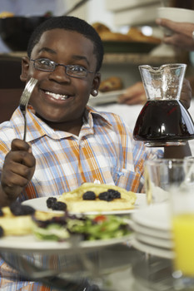
4-1 Let’s Practice
eat
What is the boy doing?
He _______.
is eating

Slide 9

4-2 SPELLING OF -ING
She is sitting.

Slide 10
4-2 SPELLING OF -ING
END OF VERB -ING FORM
*
Rule
1
A CONSONANT + -e
DROP THE -e and ADD -ing
smil
ing
e
example:
*
b,c,d,f,g,h,j,k,l,m,n,p,q,r,s,t,v,w,x,y,z

Slide 11
4-2 SPELLING OF -ING
END OF VERB -ING FORM
Rule
1
A CONSONANT + -e
DROP THE -e and ADD -ing
din
ing
e
example:

Slide 12
4-2 SPELLING OF -ING
END OF VERB -ING FORM
*
Rule
2
ONE VOWEL + ONE CONSONANT
DOUBLE THE CONSONANT and ADD -ing
sit
t
ing
example:
*
a,e,i,o,u
exception: do not double w, x, and y
pay
ying
ing
?

Slide 13
4-2 SPELLING OF -ING
END OF VERB -ING FORM
Rule
2
ONE VOWEL + ONE CONSONANT
DOUBLE THE CONSONANT and ADD -ing
plan
n
ing
ing
example:

Slide 14
4-2 SPELLING OF -ING
END OF VERB -ING FORM
Rule
3
TWO VOWELS + ONE CONSONANT
ADD -ing;
DO NOT DOUBLE THE CONSONANT
read
ing
example:

Slide 15
4-2 SPELLING OF -ING
END OF VERB -ING FORM
Rule
3
TWO VOWELS + ONE CONSONANT
ADD -ing;
DO NOT DOUBLE THE CONSONANT
sleep
ing
example:

Slide 16
4-2 SPELLING OF -ING
END OF VERB -ING FORM
Rule
4
TWO CONSONANTS
ADD -ing;
DON’T DOUBLE THE CONSONANT
brush
ing
example:

Slide 17
4-2 SPELLING OF -ING
END OF VERB -ING FORM
Rule
4
TWO CONSONANTS
ADD -ing;
DON’T DOUBLE THE CONSONANT
drink
ing
example:

Slide 18
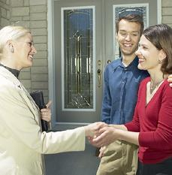
4-2 Let’s Practice
shake hands
What are the women doing?
The women _______________.
are shaking hands
Rule 1: Drop the -e and add -ing

Slide 19
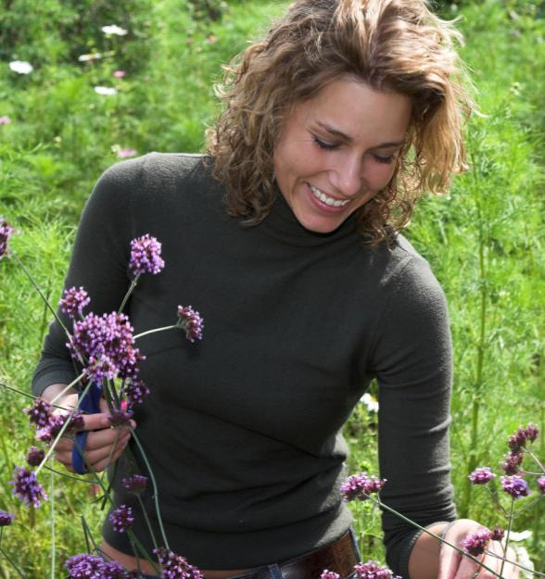
4-2 Let’s Practice
pick flowers
What is Marta doing?
Marta ______________.
is picking flowers
Rule 4: Add -ing; do not double the consonant

Slide 20
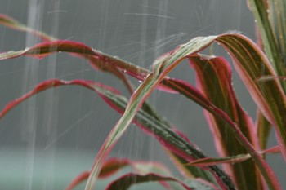
4-2 Let’s Practice
rain
What is it doing?
It is raining
_________.
Rule 3: Add -ing; do not double the consonant

Slide 21
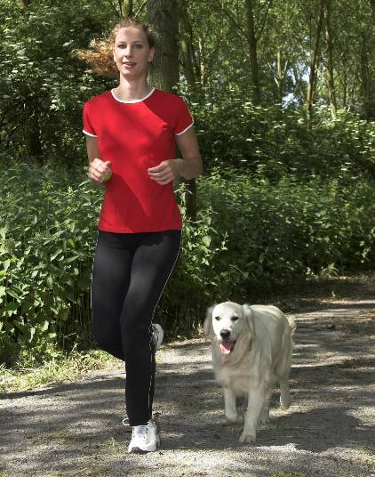
4-2 Let’s Practice
run
What is the girl doing?
The girl __________.
is running
Rule 2: Double the consonant and add -ing

Slide 22
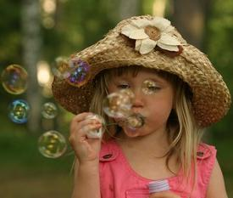
4-2 Let’s Practice
blow bubbles
What is the girl doing?
She _______________.
is blowing bubbles
EXCEPTION to Rule 2: don’t double w

Slide 23
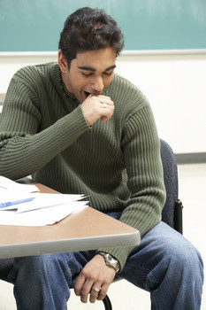
4-3 PRESENT PROGRESSIVE: NEGATIVES
He is not studying.
He is yawning.

Slide 24
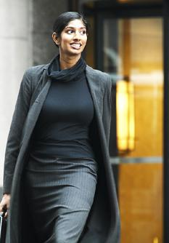
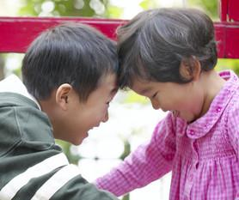
4-3 PRESENT PROGRESSIVE: NEGATIVES
(a) I am not studying.
I am yawning.
(b) Jada isn’t running.
She’s walking.
(c) Scott and Katie aren’t crying.
They’re laughing.
Present progressive negative:
am
is
are
+ not + -ing

Slide 25
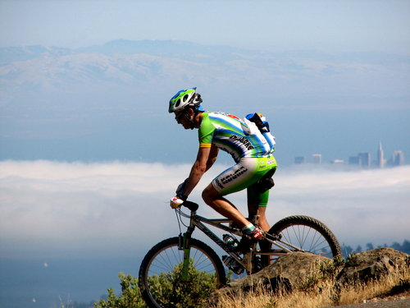
4-3 Let’s Practice
ride
David isn’t walking.
He’s _____a bike.
riding

Slide 26
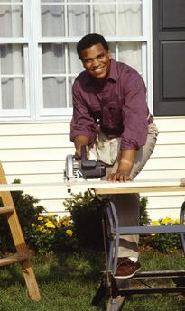
4-3 Let’s Practice
rest
work
Steven __________.
isn’t resting
He’s ________.
working

Slide 27
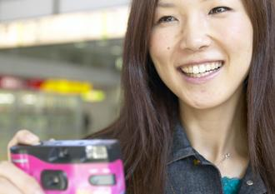
4-3 Let’s Practice
take a picture
eating
Ms. Taylor _______________.
is taking a picture
She’s _________.
not eating

Slide 28
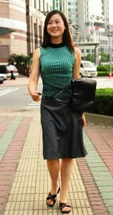
4-4 PRESENT PROGRESSIVE: QUESTIONS
Is Yu Ying walking?

Slide 29

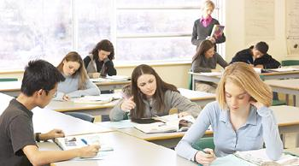
4-4 PRESENT PROGRESSIVE: QUESTIONS
SHORT ANSWER
LONG ANSWER
QUESTION
BE + SUBJECT + -ING
(a) Is Yu Ying walking?
Yes, they are.
They are studying.
Yes, she is.
She’s walking.
(b) Are they studying?

Slide 30
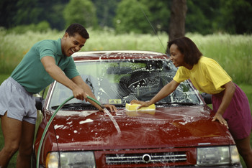
4-4 PRESENT PROGRESSIVE: QUESTIONS
SHORT ANSWER
LONG ANSWER
QUESTION
Q-WORD + BE + SUBJECT + -ING
(c) Where are they studying?
(d) What are they washing?
(e) Why are they washing the car?
Because it’s dirty.
They are washing the car because it’s dirty.
The car.
They are washing the car.
In the classroom.
They are studying
in the classroom.

Slide 31
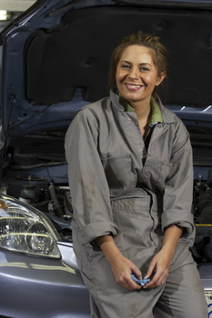
4-4 Let’s Practice
Question:
?
working on her car
Is Anchel _______________
Answer:
Yes, she is.
Anchel is working on her car.

Slide 32
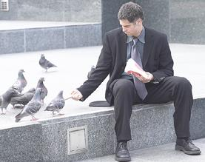
4-4 Let’s Practice
Question:
Is James feeding the birds
?
_____________________
Answer:
Yes, he is.
James is feeding
the birds.

Slide 33
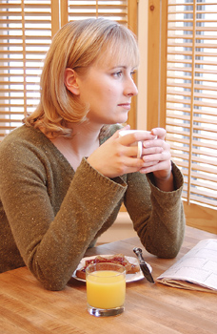
4-4 Let’s Practice
Question:
?
Is Inez drinking coffee
__________________
Answer:
Yes, she is.
Inez is drinking coffee.

Slide 34
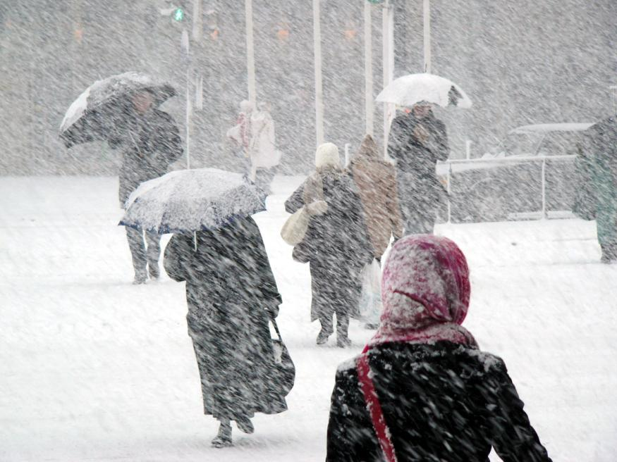
4-4 Let’s Practice
Question:
Is it raining
?
_________
Answer:
No, it isn’t.
It isn’t raining.

Slide 35
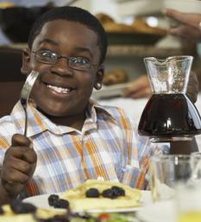
4-5 SIMPLE PRESENT TENSE vs.
THE PRESENT PROGRESSIVE
He eats pancakes
every morning.

Slide 36
4-5 SIMPLE PRESENT TENSE vs.
THE PRESENT PROGRESSIVE
STATEMENTS
He eats pancakes every morning.
(b) He is eating pancakes right now.
(c) David rides every day.
(d) David is riding right now.
simple present
habits
usual activities
present progressive
actions - now

Slide 37
4-5 SIMPLE PRESENT TENSE vs.
THE PRESENT PROGRESSIVE
QUESTIONS
(e) Does he eat pancakes every morning?
(f) Is he eating pancakes right now?
(g) Does David ride every day?
(h) Is David riding right now?
simple present do and does as helping verbs
present progressive
am, is, and are
in questions

Slide 38
4-5 SIMPLE PRESENT TENSE vs.
THE PRESENT PROGRESSIVE
NEGATIVES
(i) I don’t ride my horse every day.
(j) I’m not riding my horse right now.
(k) She doesn’t exercise every day.
(l) She isn’t exercising right now.
simple present
uses do and does
as helping verbs
present progressive
uses am, is, and are
in negatives

Slide 39
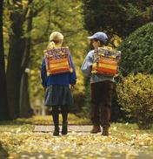
4-5 Let’s Practice
walk
Rodolfo _________ to school every day.
Right now he _________ with Amy.
walks
is walking

Slide 40
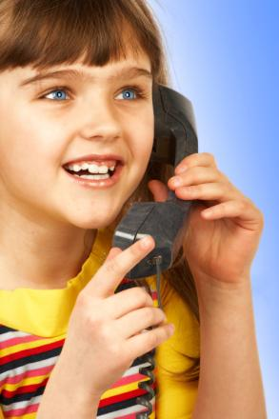
4-5 Let’s Practice
call
She ______ her grandmother every week.
Right now she ________ her.
calls
is calling

Slide 41
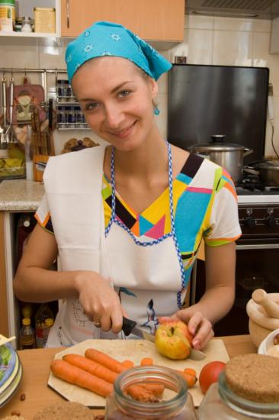
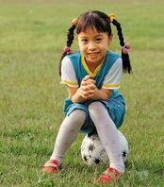
4-5 Let’s Practice
My daughter _____ soccer every day.
She _________ soccer right now.
I do not ____ soccer every day.
I ____ every day.
plays
is playing
play
cook
play
cook

Slide 42
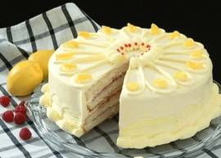
4-6 NON-ACTION VERBS NOT USED IN THE PRESENT PROGRESSIVE
I’m hungry right now.
I want some cake.

Slide 43
4-6 NON-ACTION VERBS NOT USED IN THE PRESENT PROGRESSIVE
(a) I’m thirsty right now.
I want some water.
not used
in present
progressive
?
I am wanting some water.
Nonaction verbs
want
physical or emotional need

Slide 44
4-6 NON-ACTION VERBS NOT USED IN THE PRESENT PROGRESSIVE
SOME COMMON NONACTION VERBS
dislike
hate
like
love
need
want

Slide 45
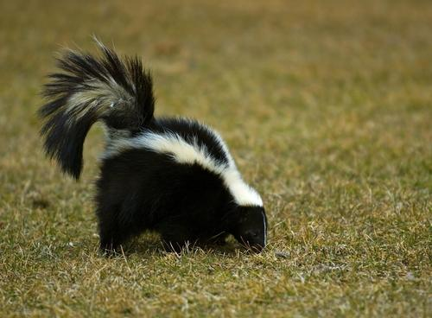
4-6 NON-ACTION VERBS NOT USED IN THE PRESENT PROGRESSIVE
Nonaction verbs
(b) I smell a skunk.
Do you smell it too?
smell
sensory experience
?
Are you smelling it too?
NOT used in
present progressive

Slide 46
4-6 NON-ACTION VERBS NOT USED IN THE PRESENT PROGRESSIVE
OTHER COMMON NONACTION VERBS
hear
see
smell
taste
believe
know
think (believe)
understand

Slide 47
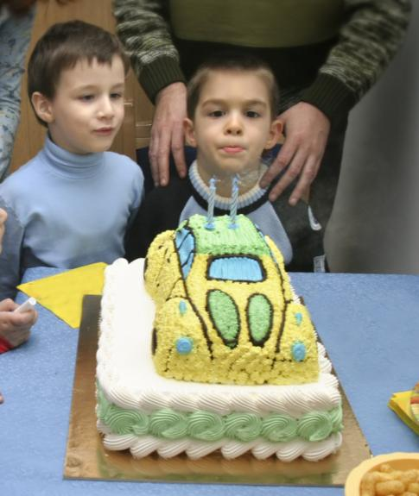
4-6 Let’s Practice
know
look
blow
know
We _____ that today is Javier’s
birthday. Javier and Jaime
__________ at the birthday
cake. Javier _________
out the candles.
are looking
is blowing

Slide 48
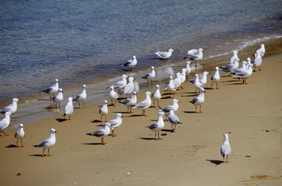
4-6 Let’s Practice
Miriam is at the beach. She ______ the salty air. She _____ the seagulls singing.
She _____ to stay at the beach forever.
smells
hears
wants
smell
hear
want

Slide 49
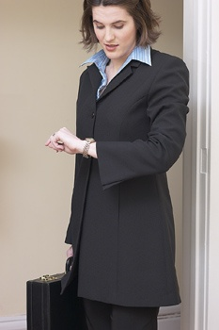
4-7 SEE, LOOK AT, WATCH, HEAR, AND LISTEN TO
She is looking
at her watch.

Slide 50
4-7 SEE, LOOK AT, WATCH, HEAR, AND LISTEN TO
(a) She sees the house.
(b) She is looking at her watch. She wants
class to end.
(c) He is watching the children.
look at
watch
see
action verb
nonaction verb
action verb

Slide 51
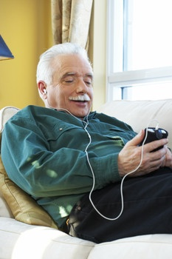
4-7 SEE, LOOK AT, WATCH, HEAR, AND LISTEN TO
(d) I hear the car horn.
(e) He’s listening to his favorite song.
hear
nonaction verb
listen (to)
action verb

Slide 52
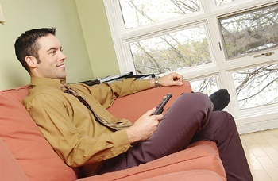
4-7 Let’s Practice
My brother _________ TV.
is watching
watch
look at
see

Slide 53
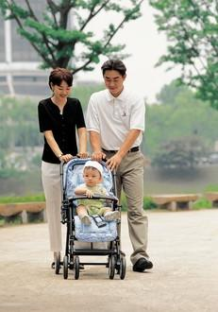
4-7 Let’s Practice
watch
look at
see
They ___________
their baby.
are looking at

Slide 54
4-7 Let’s Practice
hear
listen to
The train tracks are close to our house.
We ____ the trains every night.
hear

Slide 55
4-7 Let’s Practice
Grandpa _________ to music.
is listening
hear
listen

Slide 56

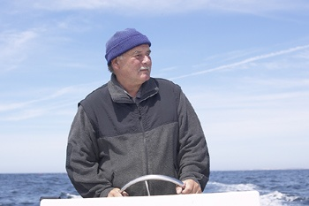
4-8 THINK ABOUT AND THINK THAT
I think about my
daughter every day.

Slide 57
4-8 THINK ABOUT AND THINK THAT
THINK + ABOUT + A NOUN
(a) I think about her every day.
(b) I am thinking about her right now.

Slide 58
4-8 THINK ABOUT AND THINK THAT
THINK + THAT + A STATEMENT
(c) I think that this game is fun.
(d) Joe thinks that the test is hard.
(e) You think that the bug is cute.
am thinking
?
I that the game is fun.
I that the game is fun.
think

Slide 59
4-8 THINK ABOUT AND THINK THAT
(f) I think that he is nice.
(g) I think he is nice.
think that
think
same
meaning

Slide 60
4-8 Let’s Practice
think (that)
think about
I __________ math is difficult .
think (that)

Slide 61
4-8 Let’s Practice
think (that)
think about
Inez ____________ her hometown a lot.
thinks about

Slide 62
4-8 Let’s Practice
think (that)
think about
Max __________ reading is fun.
thinks (that)

Slide 63
PHOTO CREDITS
Images used under license from:
Shutterstock, Inc.
Clipart.com

