Slide 1

Goal Setting
The why and the how

Slide 2
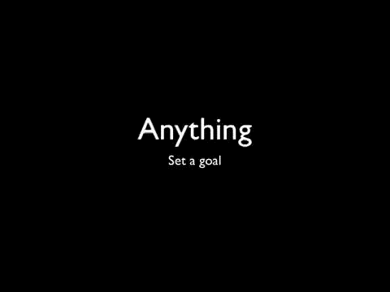

Slide 3


